Slide 1
MSE 311: Thermodynamics of Materials
Lecture 9: Specific heat
Weishu Liu
Department of Materials Science and Engineering
Southern University of Science and Technology (SUSTech)
Email: liuws@sustc.edu.cn
Office: North Tower, Rm310

Slide 2
18. Statistical ensembles
Chapter 2， 徐祖耀，材料热力学，高等教育出版社，2008
Chapter 4， Gang Chen, Nanoscale Energy Transport and Conversion, Oxford, 2005

Slide 3
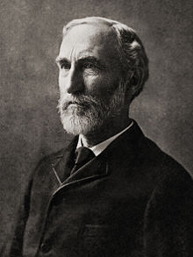
Statistical ensembles
1902, J. Willard Gibbs proposal the concept of statistical ensemble
Statistical ensemble: an idealization consisting of a large number of virtual copies (sometimes infinitely many) of a system, considered all at once, each of which represents a possible state that the real system might be in.
A statistical ensemble is a probability distribution for the state of the system
Gibbs, Josiah Willard (1902).
Elementary Principles in Statistical Mechanics. New York
Josiah Willard Gibbs
1839-1903

Slide 4
Ergodic hypothesis （遍历假设）
In an actual experiment, we usually need consider a time-averaged behavior for a system by solving Newton’s equation of motion or time dependent Schodinger Equation
The introduce of statistical ensemble avoid the time average
The ensembles average of a observed quantity is equal to the time average of the same quantity.

Slide 5
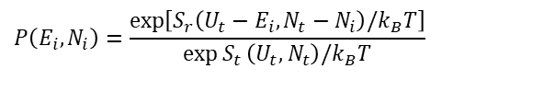
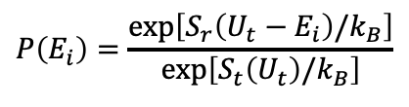
Ensemble
Microcanonical
Ensemble
Canonical
Ensemble
Grandcanonical
Ensemble
isolated systems
close systems
open systems
TD potential
Partition function
Probable
Distribution
$$P\left(E_{i}\right)=\frac{\exp\left[S_{r}\left(U_{t}−E_{i}\right)/k_{B}\right]}{\exp\left[S_{t}\left(U_{t}\right)/k_{B}\right]}$$
$$P\left(E_{i},N_{i}\right)=\frac{\exp\left[S_{r}\left(U_{t}−E_{i},N_{t}−N_{i}\right)/k_{B}T\right]}{\exp{S_{t}}\left(U_{t},N_{t}\right)/k_{B}T}$$

Slide 6
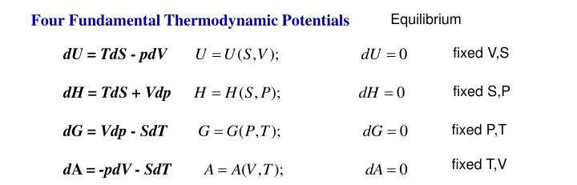
Thermodynamics Potential
Microcanonical
Ensemble
Canonical
Ensemble
Grandcanonical
Ensemble
isolated systems
close systems
open systems
TD potential
U and H are also thermodynamics Potential.
This is not Gibbs free energy

Slide 7
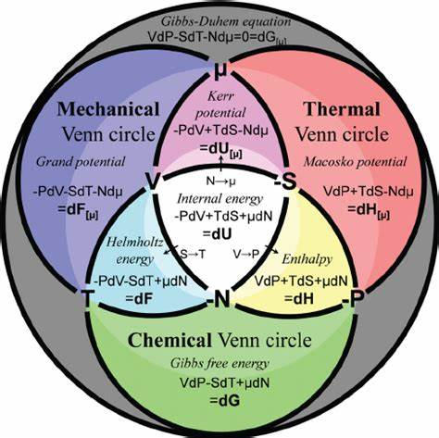
Thermodynamics Venn diagram
Grandcanonical Potential
Canonical Potential
American Journal of Physics 79, 950 (2011)

Slide 8
The Bose-Einstein Distribution
For other case, such as gas molecules, can have a fixed number of particles
We should use grand canonical ensembles as Fermions
The general Bose-Einstein distribution
The general Fermi-Dirac distribution
$$\left\langle n\right\rangle \text{=}f\left(E\right)=\frac{1}{1+\exp\left[\frac{E−μ}{k_{B}T}\right]}$$
The general Maxwell-Boltzmann distribution
Notes:
Darwin–Fowler method

Slide 9
19. Statistical thermodynamic interpret of Heat capacity
Chapter 4 and 5, Introduction to Solid State Physics, C. Kittle, Wiley, 2004

Slide 10
Heat capacity: c_{V} and c_{P}
Constant Volume Process (C_{V}):
dU = δq – δW = δq
or dU=C_{v}dT
Constant Pressure Process (C_{P}):
dH =dU+pdV= δq
or dH=C_{P}dT

Slide 11
Heat Capacity: c_{V} and c_{P}
Represents the work done by the system per degree rise in temperature in expanding against the constant external pressure P acting on the system
Represents the work done by the system per degree rise in temperature in expanding against the internal cohesive forces acting between the constituent particles of the substance
For idea gas

Slide 12
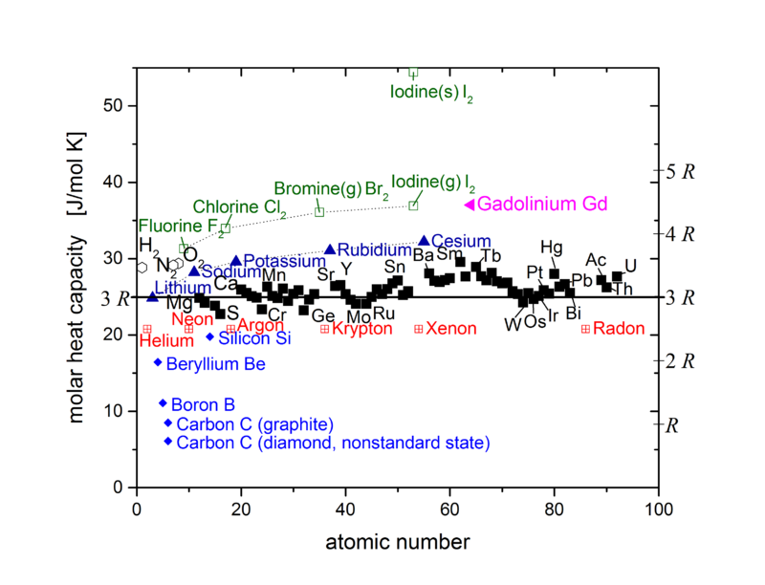
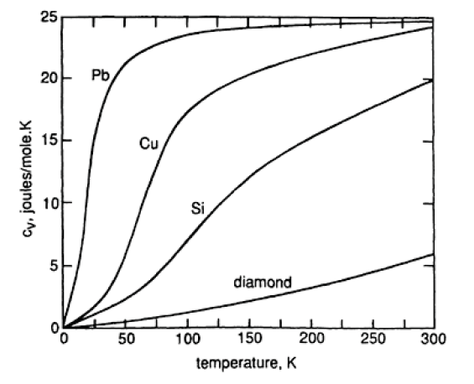
Dulong-Petit Rule
3R rule for the thermal conductivity!
Experimental shows that
3R rule is only valid as T is high enough
Cv is temperature dependent

Slide 13
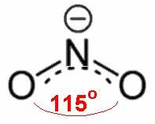
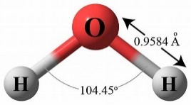
Equipartition of energy
each degree of freedom would have an average energy in the amount of k_{B}T/2
The possible degree of freedom include: translation, rotation and vibration
Internal energy and specific heat
The monatomic gas
The diatomic gas
More complicate molecular
N₂O: f=13
H₂O: f=12
Open question

Slide 14
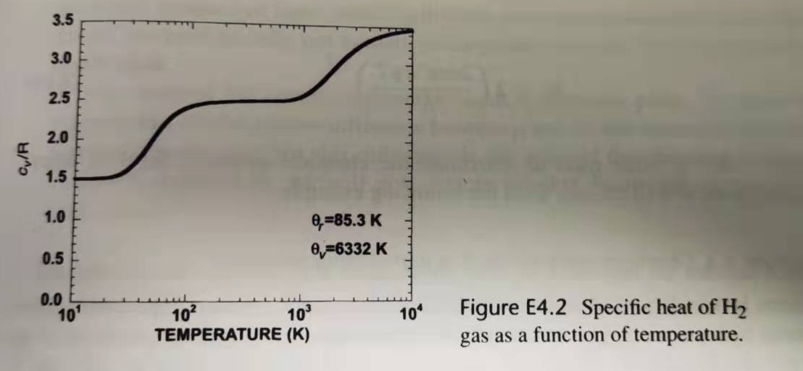
Specific heat of H₂
Transitional
part
Rotational
part
Vibration
part
rotational temperature of a hydrogen molecular is 85.3 K,
vibrational temperature is 6332K,

Slide 15
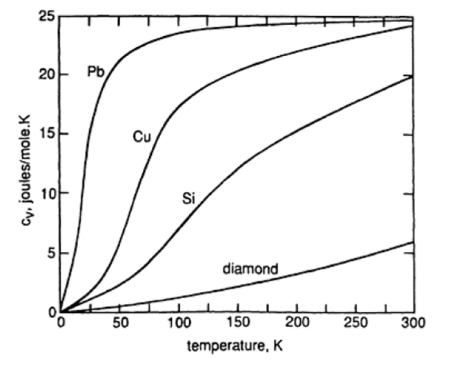
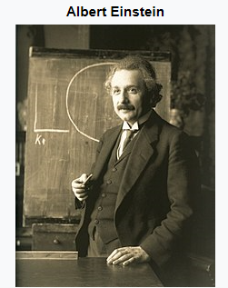
Einstein model
Frequency
Γ
Wave Vector
Einstein model, 1907
A crystal containing n atoms, each atom behaves as a harmonic oscillator vibrating independently about its lattice point.
As the behavior of each oscillator is not influenced by the behavior of its neighbors, each oscillator vibrates with a single fixed frequency v
A system of such oscillators is called an Einstein crystal.

Slide 16
Einstein model
Quantized energy
As each oscillator has three degrees of freedom, i.e., can vibrate in the x, y, and z directions,
the energy, U’, of the Einstein crystal (which can be considered to be a system of 3n linear harmonic oscillators) is given a
Partition function

Slide 17
Einstein model
Defining hv/k=θ_{E}, where θ_{E} is the Einstein characteristic temperature,
n equal to Avogadro’s number N_{a}, nk_{B} =R

Slide 18
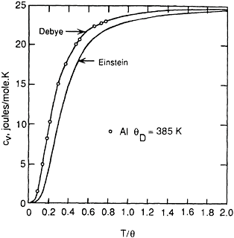
Einstein model of c_{V}
as T/θ increases, Cv→ 3R , in agreement with Dulong and Petit’s law,
as T → 0, Cv→ 0, which is in agreement with experimental observation.
Experimental data
There is some discrepancy between experimental data and Einstein’s model
because of the assumption the oscillators vibrate with a single frequency

Slide 19
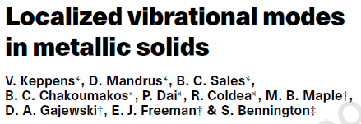
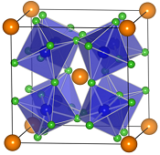
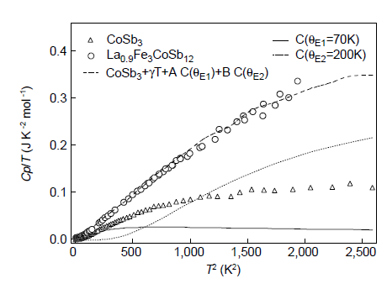

Nature 395, 876 (1998)

Slide 20
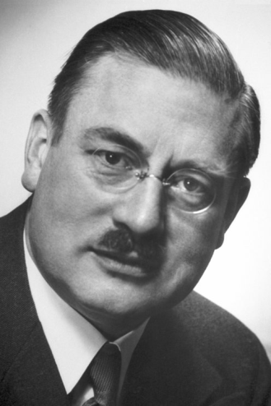
Debye model of c_{v}
Phonon
velocity
Angular
frequency
Frequency
Wave
vector
Γ
Wave Vector
Peter Debye
1884-1966
linear dispersion relationship
Cut-off frequency: ω_{D}
Cut-off frequency: k_{D}
Wave
vector
Nobel Prize in Chemistry 1936
Einstein’s assumption:
the assumption the oscillators vibrate with a single frequency
Debye’s modification:
the oscillators vibrate with in a rang of frequency

Slide 21
Debye model of c_{v}
Frequency distribution
D(ω)
frequency distribution function of vibration mode
linear dispersion relationship
Debye Frequency
number of phonons
distribution
density
volume of spherical shell
number of phonons

Slide 22
Debye model of c_{v}
<n(ω)>
Thermal equilibrium occupancy of wavevector k
It follows the Bose-Einstein distribution
The factor of 3 accounts for
the three phonon polarizations.
Debye Frequency
Debye heat capacity function contains
only one parameter Debye temperature.

Slide 23
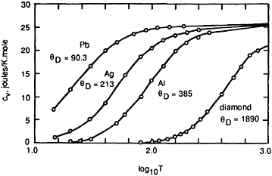
Debye model of c_{v}
The materials with heavier atom has smaller θ_{D}
Figure 6.3 The constant-volume molar heat capacities of several solid elements. The curves are the Debye equation with the indicated values of θD.

Slide 24
Debye model of c_{V}
Debye’s T³ –Law
for low temperature heat capacity
Some limitation of Debye’s mode:
The introduction of cut-off seems very arbitrary，not make sense
Linear dispersion relationship is not true at high wave vector

Slide 25
20. Sine dispersion relation

Slide 26
A real dispersion relationship
Einstein’s assumption:
the assumption the oscillators vibrate with a single frequency
Debye’s modification:
the oscillators vibrate with in a rang of frequency

Slide 27
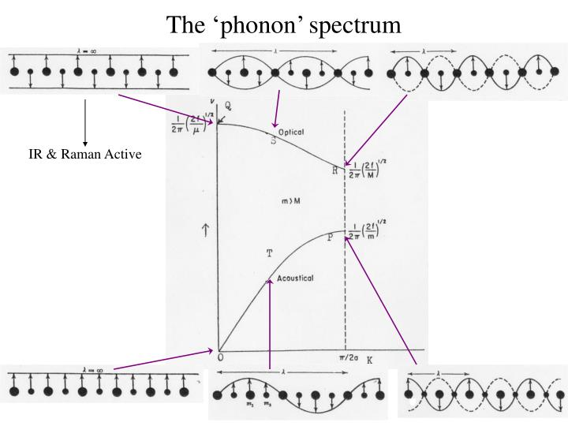
Acoustic phonon Vs. Optical Phonon

Slide 28
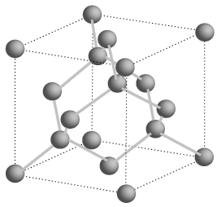
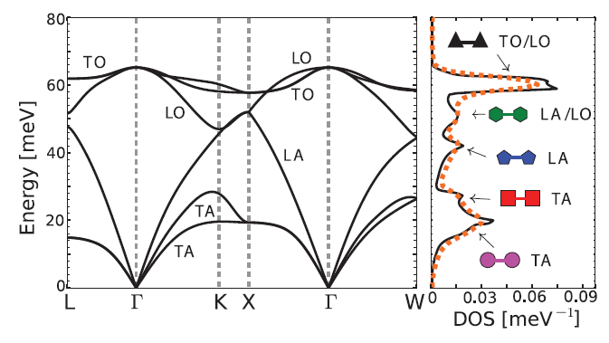
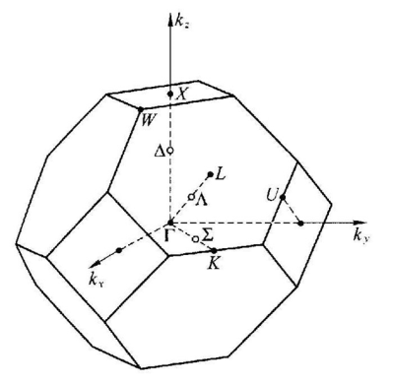

Phonon Spectrum of Si

Slide 29
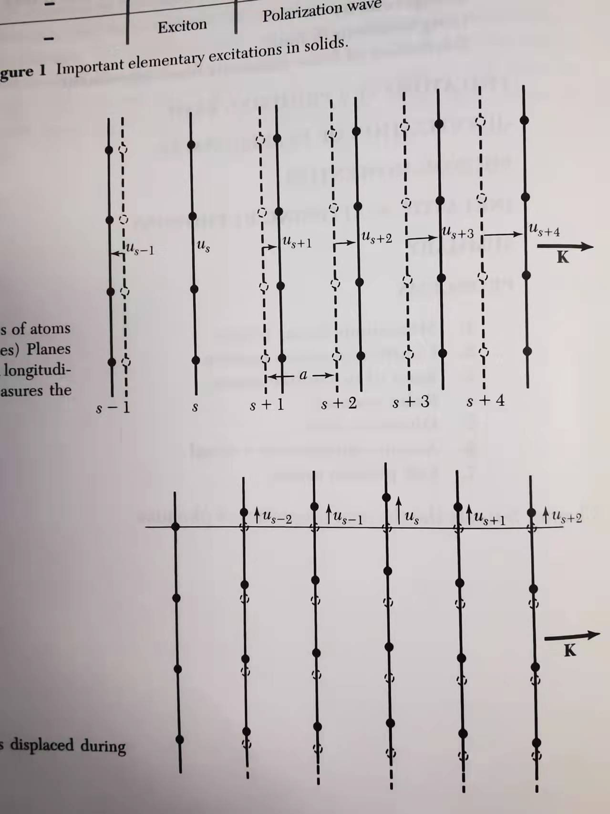
Solution of Phonon dispersion relationship
Disperse as longitudinal wave
Total force on s plane from s+1 and s-1 plane
Hooke’s law
The equation of motion
Disperse as transverse wave
Solution
The equation of motion
The dispersion relation
G. Kittle, Introduction to Solid State Physics, Wiley, 2005

Slide 30
Density of states
with sine dispersion relation
Assuming that the phonons of three –dimensional crystal obey the following isotopic dispersion relationship
The density of states
The number of states
Group velocity
Phase velocity
From the line dispersion relation
From the sine dispersion relation

Slide 31
Heat capacity
with sine dispersion relation
Standing wave condition

Slide 32
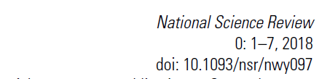
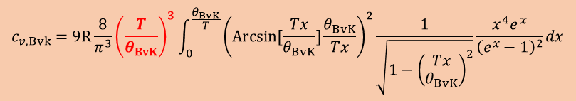
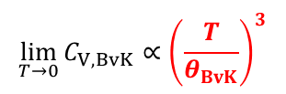

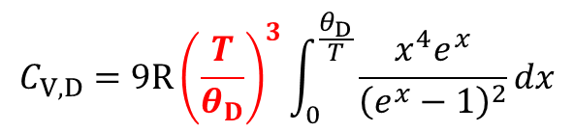
Heat capacity
with sine dispersion relation
Sine dispersion
Linear dispersion
as k<< k_{c}
$$c_{v,Bvk}=9R\frac{8}{π^{3}}{\left(\frac{T}{θ_{BvK}}\right)}^{3}\int_{0}^{\frac{θ_{BvK}}{T}}{{\left(Arcsin[\frac{Tx}{θ_{BvK}}]\frac{θ_{BvK}}{Tx}\right)}^{2}\frac{1}{\sqrt{1−{\left(\frac{Tx}{θ_{BvK}}\right)}^{2}}}\frac{x^{4}e^{x}}{{\left(e^{x}−1\right)}^{2}}}dx$$
$$C_{V,D}=9R{\left(\frac{T}{θ_{D}}\right)}^{3}\int_{0}^{\frac{θ_{D}}{T}}{\frac{x^{4}e^{x}}{{\left(e^{x}−1\right)}^{2}}}dx$$
$$\lim_{T→0}{C_{V,BvK}}∝{\left(\frac{T}{θ_{BvK}}\right)}^{3}$$
$$\lim_{T→∞}{C_{V,BvK}}=3R$$
Notes:
arcsin x = sin⁻¹ x ， sin( arcsin x ) = x

Slide 33
Heat capacity
with sine dispersion relation
Pei’s mode covering both the features
of Einstien’s model and Debye’s mode

Slide 34

Estimation of lattice thermal conductivity
David G. Cahill
The relax time is equal to the half of the vibration circle
Lattice thermal conductivity reach the minimum

Slide 35
Estimation of lattice thermal conductivity
Debye-Slack
Debye-Snyder
Over estimated ~40%

Slide 36
Sine + Constant dispersion assumption
n=1
n=2
n=3
n=4
n=5
n=6

Slide 37
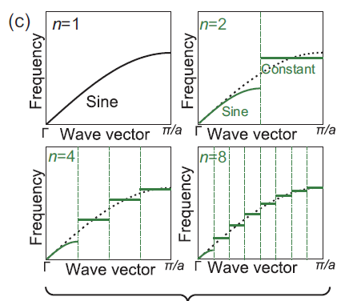



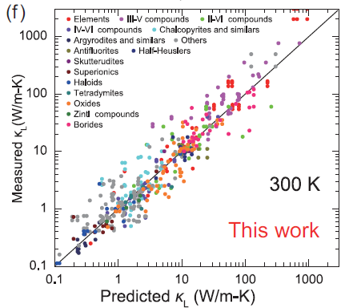
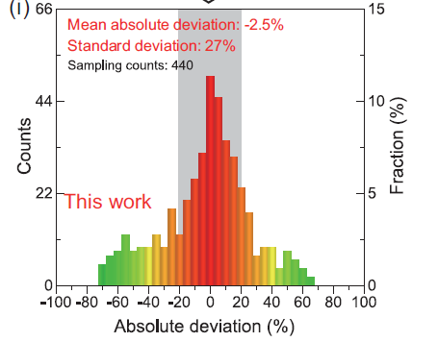
Estimation of lattice thermal conductivity

Slide 38
Estimation of κ_{min}
Frequency
Sine dispersion
Γ
Wave Vector
Frequency
Linear dispersion
Γ
Wave Vector
Pei used the linear dispersion approximation
And give a lower κ_{min}

Slide 39
21. Other contribution to heat capacity

Slide 40
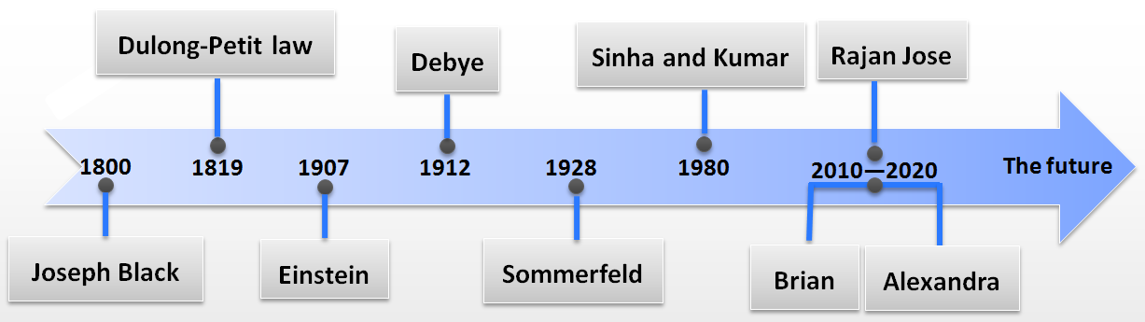
The heat capacity of matter at low temperature
1800 Black first proposed the concept of heat capacity
1819 Dulong-Petit Law
1907 Einstein Model
1912 Debye Model
1928 Electronic heat capacity - Sommerfeld
1963 Rosenberg proposed the Schottky anomaly of heat capacity in solids
1980 Magnetic heat capacity - Sinha and Kumar
1992 Elliott discovered the Boson peak anomaly in heat capacity
2010-2020 Calorimetry, New model and Application
1. Lattice heat capacity
2. Electronic heat capacity
3. Magnetic heat capacity
4. Heat capacity anomalies
Notes:
从研究历史也可以发现固体的比热大致包含以下几类：晶体比热、电子比热、磁比热、异常比热
1800布莱克首次提出比热的概念
1819杜隆泊替定律
1831纽曼-科普定律进一步发展了杜隆泊替定律
1907年随着低温技术的发展，随着温度的降低，比热迅速减小，爱因斯坦基于量子理论提出了爱因斯坦模型
1912年，随着温度的进一步降低，在20K以下，爱因斯坦模型和实验结果差别较大，德拜提出德拜模型
1928年索末菲提出自由电子气模型，并由此推导出了电子比热
1963年，Rosenberg提出了固体中的肖特基异常比热
1980年，Sinha and Kumar在前人的基础上系统的提出了各种磁作用的比热
1992年，Elliott首次发现了波色峰
2010-2020进入21世纪，比热的研究主要集中在量热学、新型比热拟合模型的开发、比热在物理现象解析中的应用

Slide 41
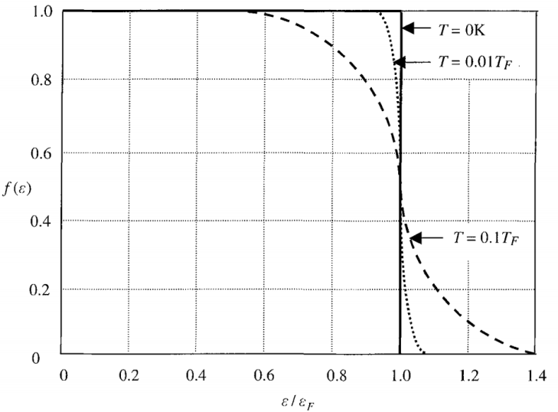
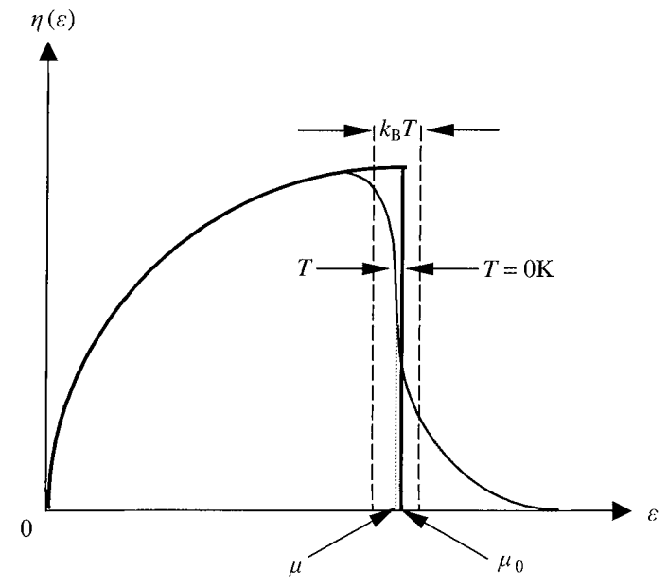
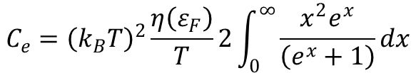
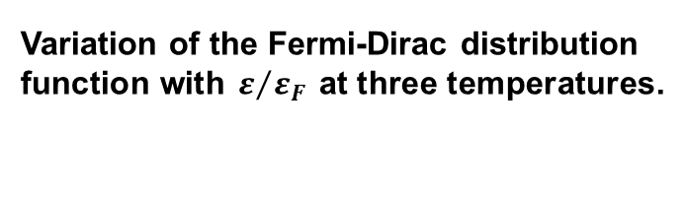


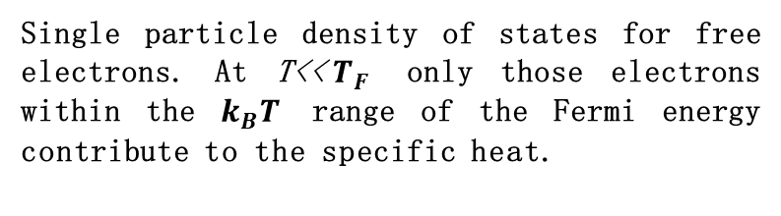
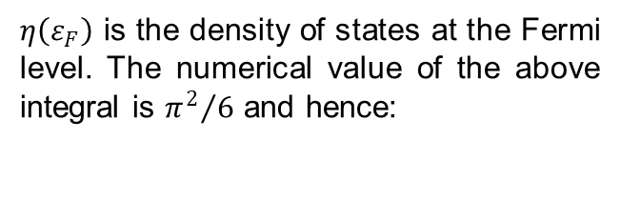
Electronic heat capacity
When a gas consisting of N electrons (N is assumed to be very large) is in thermal equilibrium the probability that a particular energy level e is occupied is given by the Fermi-Dirac distribution function
$$f\left(ε\right)=\frac{1}{e^{{\left(ε−μ\right)}/{k_{B}T}}+1}$$
Variation of the Fermi-Dirac distribution function with $ε/{ε_{F}}$ at three temperatures.
$$C_{e}={\left(k_{B}T\right)}^{2}\frac{η\left(ε_{F}\right)}{T}2\int_{0}^{∞}{\frac{x^{2}e^{x}}{\left(e^{x}+1\right)}}dx$$
$η\left(ε_{F}\right)$ is the density of states at the Fermi level. The numerical value of the above integral is ${π^{2}}/6$ and hence:
Single particle density of states for free electrons. At T<<$T_{F}$ only those electrons within the $k_{B}T$ range of the Fermi energy contribute to the specific heat.
$$C_{e}=\frac{1}{3}π^{2}k_{B}^{2}η\left(ε_{F}\right)T=γT$$
Kittel C., McEuen P., McEuen P. Introduction to Solid State Physics[M]. Wiley, New York, 1976, Vol. 8

Slide 42
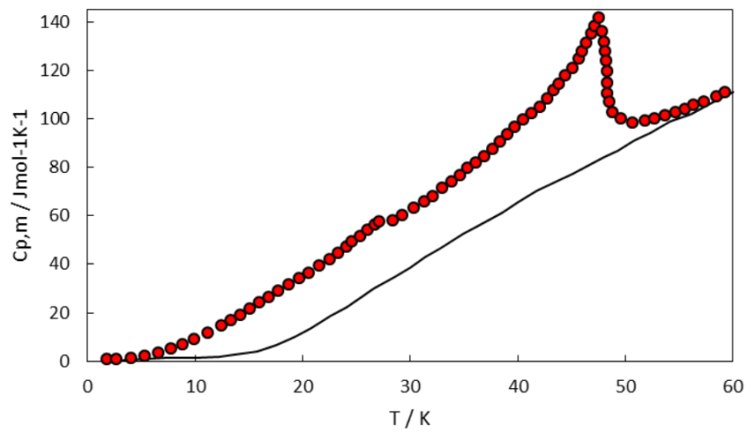
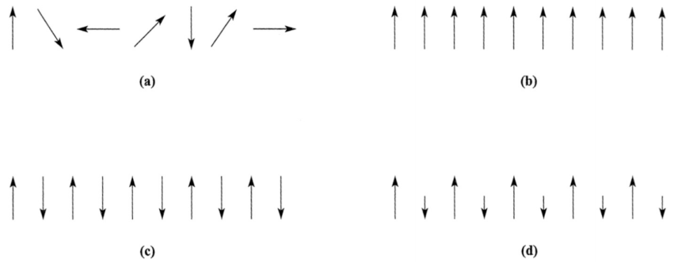
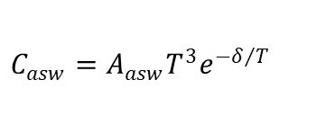
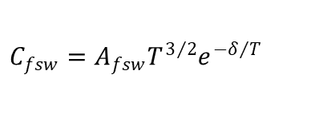


Magnetic heat capacity
The heat capacity of Fe₄(P₂O₇)₃ around magnetic transition
Paramagnetism, (b) Ferromagnetism,
(c) Antiferromagnetism, (d) Ferrimagnetism
There is a dispersion relation between the frequencies of different phases and the number of spintrons at these frequencies.
Ferromagnetism
Ferromagnetism
$$ω_{q}=α_{f}\frac{2Jsa^{2}}{h}q^{2}$$
$$C_{fsw}=A_{fsw}T^{3/2}e^{−δ/T}$$
Antiferromagnetism
Antiferromagnetism
$$ω_{q}=α_{a}\frac{2J^{′}sa^{2}}{h}q^{2}$$
$$C_{asw}=A_{asw}T^{3}e^{−δ/T}$$
Fisher R. A., Bouquet F., Phillips N. E., et al. Physical Review B, 2001, 64: 134425.

Slide 43
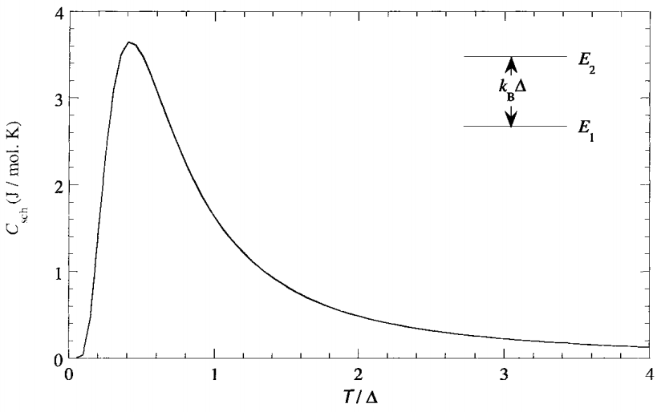
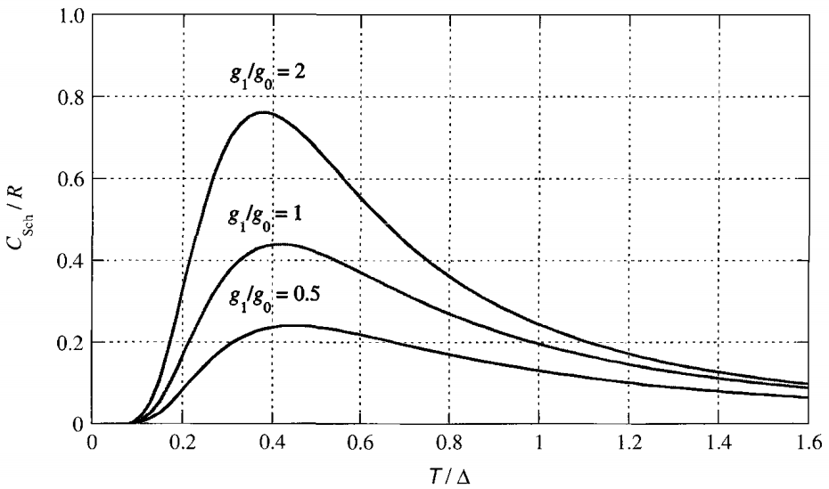
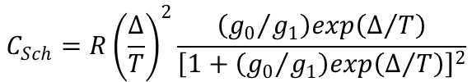
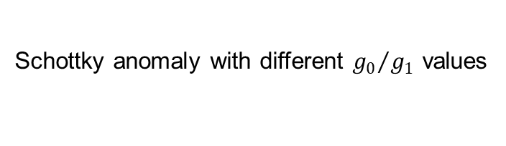
Heat capacity anomaly: Schottky anomaly
Schottky anomaly with different ${g_{0}}/{g_{1}}$ values
$$C_{Sch}=R{\left(\frac{∆}{T}\right)}^{2}\frac{\left({g_{0}}/{g_{1}}\right)exp\left(∆/T\right)}{{\left[1+\left({g_{0}}/{g_{1}}\right)exp\left(∆/T\right)\right]}^{2}}$$
Klotz S., Steinle-Neumann G., Strässle T., et al. Physical Review B, 2008, 77: 012411.

Slide 44
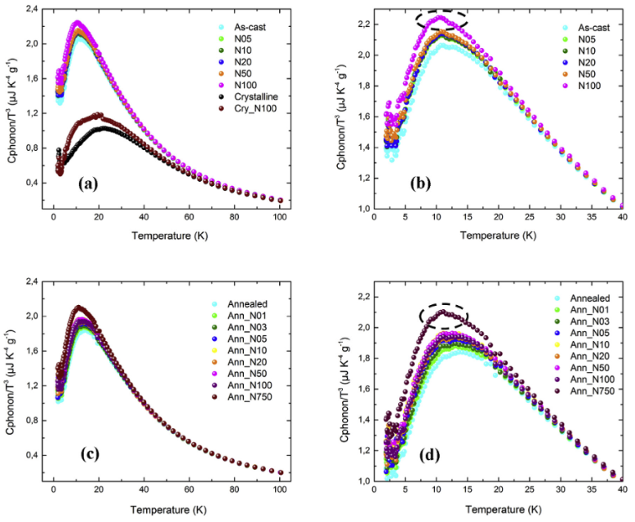
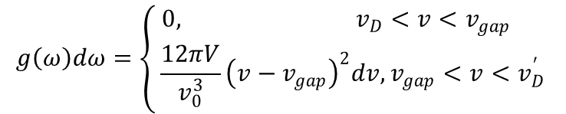
Boson peak anomaly
Low-temperature boson heat capacity peaks:
as-cast set and crystalline set,
partial enlargement of the as-cast set,
annealed set
partial enlargement of the annealed set.
$$g\left(ω\right)dω=\left\{\begin{aligned} 0, v_{D}<v<v_{gap} \\ \frac{12πV}{v_{0}^{3}}{\left(v−v_{gap}\right)}^{2}dv,v_{gap}<v<v_{D}^{′}\end{aligned}\right.$$
Gil L., Ramos M., Bringer A., et al. Physical Review Letters, 1993, 70: 182.

Slide 45
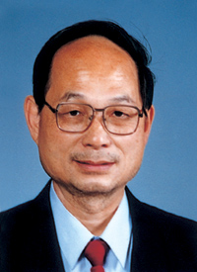
陈难先院士
At the low T limit
At the high T limit

Slide 46
22. Engineering considering of heat capacity

Slide 47
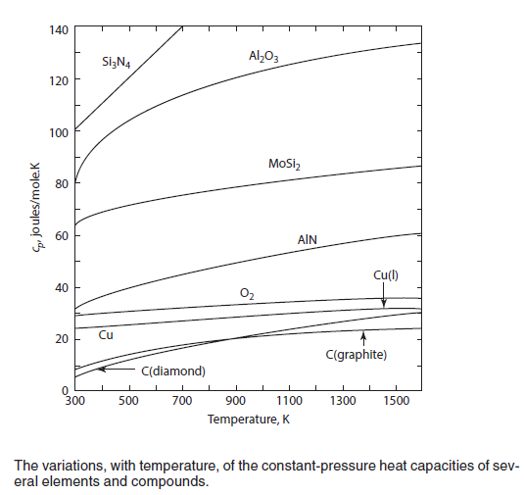
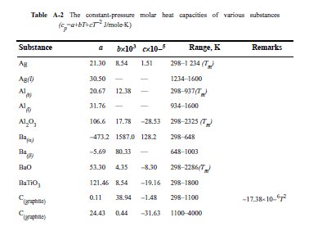
The Empirical representation of heat capacity
The experimentally measured variation of the constant-pressure molar heat capacity of a material with temperature is normally fitted to an expression of the form

Slide 48



The Empirical representation of heat capacity
298-2670K
1478-2670K
heat capacities (c_{p} ) increased with temperature
heat capacities (c_{p} ) of some elements which exhibit allotropy and some compounds which exhibit polymorphism.

Slide 49



Partial liquid-like sub-lattice

Slide 50


Temperature dependent C_{p}
Regular materials
Cu₂Se
500K
700K
900K
1100K
Acta Materialia，2015

Slide 51
Entropy as a function of temperature
For a closed system of fixed composition
undergoing a change in temperature from T₁ to T₂ at the constant pressure P
c_{p}
ΔH
T₁
T₂

Slide 52





Enthalpy-Temperature diagram
Considering a melting process
Kirchhoff ’s Law
If Δc_{p}=0, then ΔH_{T1} = ΔH_{T2}

Slide 53

Enthalpy as a function of temperature
When a system undergoes a chemical reaction or a phase transformation at constant temperature and pressure, e.g.,
A+B=AB
ΔH is the difference between the enthalpy of the products of the reaction (the state 2), and the enthalpy of the reactants (the state 1), i.e
Endothermic process: ΔH is positive
Exothermic process: ΔH is negative

Slide 54






Enthalpy-Temperature diagram
H does not have an absolute value (only changes in H can be measured)
This convention assigns the value of zero to the enthalpy of elements in their stable states at 298 K (25°C)
The T-dependent heat of chemical reaction

Slide 55





Enthalpy-Temperature diagram
(a). 298 to 600 K
(b). 600 K
(c). 600 to 1200 K
Prof. W.S. Liu | 55

Slide 56









Effect of pressure on the H and S
Case-I
Maxwell’s equation
Apply dH=TdS+VdP, and thus
Maxwell’s equation
Case-II
For a closed system of fixed composition undergoing changes in both P and T

Slide 57




The third Law of Thermodynamics
In 1906 Nernst postulated that, for chemical reactions between pure solids or pure liquids,
For a closed system undergoing a reversible process, the Second Law gives
If the process is conducted at constant pressure, then
Nernst’s heat theorem states that
“for all reactions involving substances in the condensed state, ΔS is zero at the absolute zero of temperature.”

Slide 58
The amendment of Nernst’s Statement
The incompleteness of Nernst’s theorem was pointed out by Planck, who stated that “the entropy of any homogeneous substance, which is in complete internal equilibrium, may be taken to be zero at 0 K.”
1. Glass
At temperatures lower than its equilibrium freezing tem-perature the glassy state is metastable with respect to the crystalline state,.
and a glass, not being in internal equilibrium, has an entropy at 0 K which is greater than zero by an amount which is dependent on the degree of atomic disorder in the glass
2 Solution
atomic mobility decreases exponentially with decreasing temperature, the maintenance of internal equilibrium becomes increasingly difficult.
Consequently a nonequilibrium degree of order can be frozen into the solid solution, in which case the entropy will not decrease to zero at 0 K

Slide 59
Open questions:
1. Find a thermodynamic equation and discussion the possible limitation with in the dimension of space and time
2. Find some NEW example to discuss the reason why the 3nd Law of thermodynamics of Nernst’s theorem is failing, whether the Planks' modification solve your problem.
3. Discuss the possible case that needs modify the assumption of the Debye model for the heat capacity.
4. Find a new example to use the local vibrational mode to obtain the material with intrinsically low thermal conductivity.

Slide 60
23. Gruneisen parameter

Slide 61

Gruneisen parameter
Griineisen’s rule
The thermal expansion of solid is proportion to the specific capacity
Gruneisen parameter γ，is considered as a continent measure of the anharmonicity of the crystal
Debye temperature and Gruneisen parameter γ

Slide 62
Grunerisen parameter
The microscopic definition of the Grüneisen parameter (Grüneisen 1912)
As γ_{i} are not all equal,
T → 0
Empirical γ is observed constant over a wide range of temperatures above 0.3θ_{D}
It is reasonable to take γ_{G} as roughly equal to the theoretical γ∞

Slide 63
Lindemann Law
m, is the mean mass of an atom;
a, is the mean interatomic spacing;
f , is the Lindemann ratio
M, molar mean mass of atom;
V, molar mean atom volume;
f , is the Lindemann ratio
α, structure facture relative the atomic space, α~1
b, number of atoms per volume.
n, number of atoms in the primitive cell.
Phys. Earth and Planetary Interiors,
54 (1989) 364-369
PHYSICAL REVIEW B 95, 155206 (2017)

Slide 64
Mie-Lennard-Jones
As the interamoic potential
is known
Mie-Lennard –Jones potential
Grüneisen parameters
Grüneisen parameters
T → 0
For a inert gas solid

Slide 65


Gruneisen parameter and Thermal conductivity
Glen A. Slack’s formula
Umklapp scattering dominant
Neglect optical phonon
G. Slack, J. Phys. Chem. Solids 34, 321 (1973).

Slide 66

The anharmonicity is amplified by the presence of lone-paire s electron that are localized in large outer shells around
When lattice wave displace atoms, the s-electrons shell become strongly distorted and may lead to very anharmonic bonds.

